Slide 1
Risk Management

Slide 2
What is Risk?
The effect of uncertainty on objectives.

Slide 3
What is Risk Management ?
Informed decision making –
NOT only for compliance
Minimizing harm, maximizing opportunity –
NOT only considering negative effects
Embracing uncertainty, enabling innovation –
NOT assuming we can predict the future
A consultative process and team effort –
NOT a desk job of one person

Slide 4
BECOMING A RISK-INFORMED ORGANIZATION

Slide 5
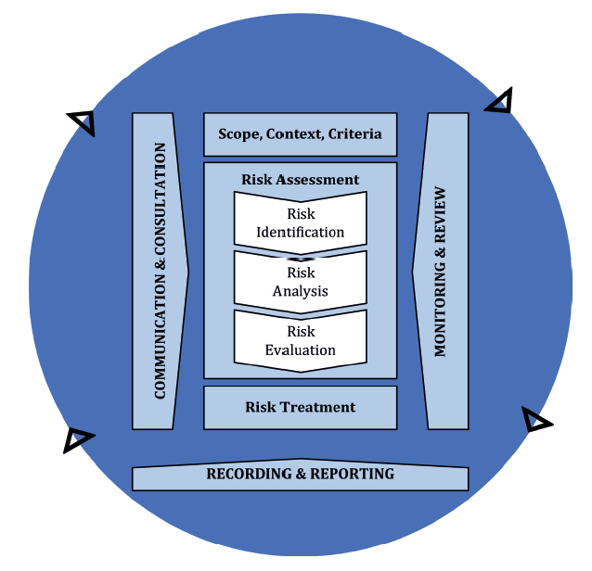
UNDP’s Integrated Approach to Risk Management
Financial
Operational
Organizational
Political
Regulatory
Strategic
Social and Environmental
Global Corporate
Unit/Programme
Projects
Safety & Security

Slide 6
Risk Management Tools
ERM Dashboard (Power BI)
Capacity assessments of partners, including HACT
UNDP Anti-Fraud Policy
UN Programme Criticality Framework
Security Risk Management (SRM) and Business Continuity Management
Due Diligence for the Private Sector
Programme/Project Quality Assurance - Dashboard
Social and Environmental Standards and Screening Procedure
Theory of Change
Audits and Evaluations
Procurement Ethics, Fraud and Corrupt Practices Policy, Procurement Strategy/Planning
Procurement Risk Radar
Crisis Risk Dashboard
RISK REGISTER

Slide 7
UNDP’s Risk Register
Unit/Programme
Projects
Global Corporate
Quantum+
Quantum

Slide 8
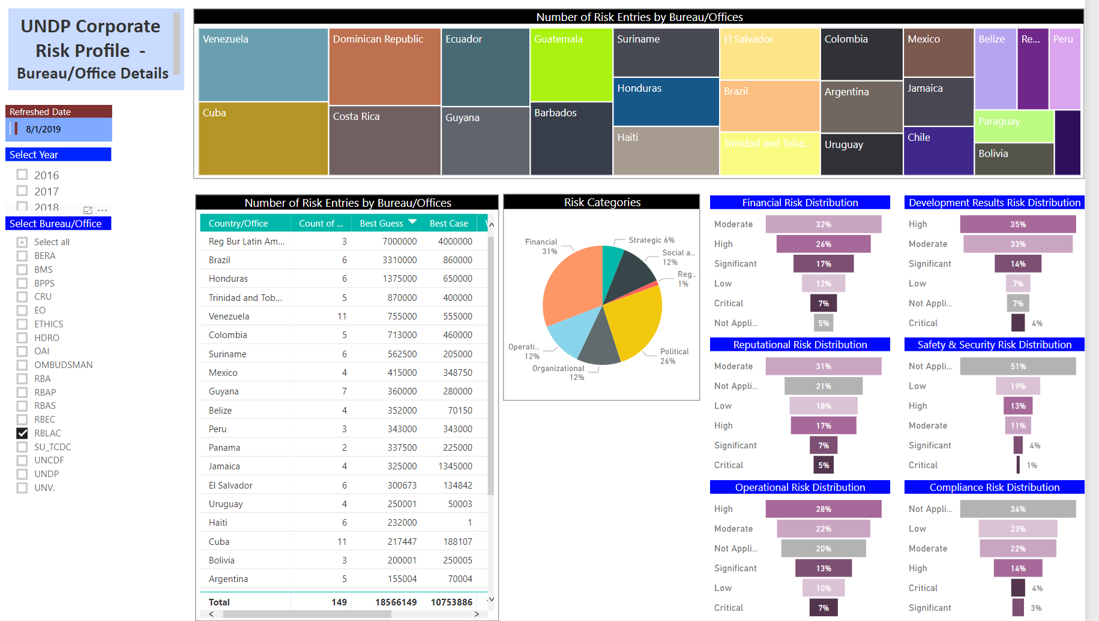
ERM Dashboard – RBLAC Corporate Risk Profile

Slide 9
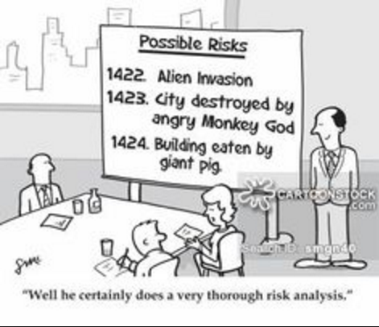
Things to remember about Risk “Uncertainty that Matters” David Hillson
QUICK TIPS
Discussion between programme and operations
Engage stakeholders
Understand changing context
Use available tools to identify and assess risks
Link impact to objectives
All risks are uncertainties, not all uncertainties are risks!

Slide 10
Risk Identification and Assessment
Risk re-assessment, treatment and Monitoring and reporting
Changing context

Slide 11
Quantifying Financial Impact
Financial impact is NOT:
The “opportunity loss” that the organization suffers when the risk materializes
The cost of prevention and risk mitigation measures
Monetized amount of loss of productivity (e.g. staff time, running cost, etc.)

Slide 12
Costing Risk Management
Needs to be considered in programme/project design
Needs to be costed in budgets
Includes necessary activities to implement treatment measures

Slide 13
DISCUSSION/Q&A

